Slide 1
Medical Dashboard
Hospital Management System
Group: 16
No. | Name | Roll no.
1. | Omkar Najan | PG-05
2. | Aditya Mhaske | PG-12
3. | Atharv Nikam | PG-21
4. | Vipul Dunde | PG-32

Slide 2
INTRODUCTION
Medical dashboard [MD], a Hospital Management System, is a central modular concept to provide all medical management tools related to Doctor, Patient, Staff etc.
Medical Dashboard is more of an audit trail of doctors encounters with patients. MD can be a modern way of a hospital treating the patients. MD covers past history, prescription suggested by doctors, laboratory reports. This means all vital information is residing in the system, which can be readily retrieved to help in making a timely decision.

Slide 3
OBJECTIVES
To computerize all details regarding patient & hospital details
Scheduling the appointment of patient with doctors for convenience.
Scheduling the services of specialized doctors and emergency properly so that facilities provided by hospital are fully utilized in effective and efficient manner.
It should be able to handle the test reports of patients conducted in the pathology lab of the hospital
The inventory should be updated automatically whenever a transaction is made
The information of the patients should be kept up to date and there record should be kept in the system for historical purposes.

Slide 4
SCOPE
The proposed software product is the Medical Dashboard. The system will be used in any Hospital, Clinic, Dispensary or Pathology labs to get the information from the patients and then storing that data for future usage
The current system in use is a paper-based system. It is too slow and cannot provide Updated lists of patients within a reasonable timeframe. The intentions of the system are to reduce overtime pay and increase the number of patients that can be treated accurately. Requirements statements in this document are both functional and non-functional

Slide 5
TECHNOLOGY USED
DATABASE: MySQL database
Platform: Windows OS
Web based application: HTML, CSS, JAVASCRIPT, JAVA, APACHE FRAMEWORK

Slide 6
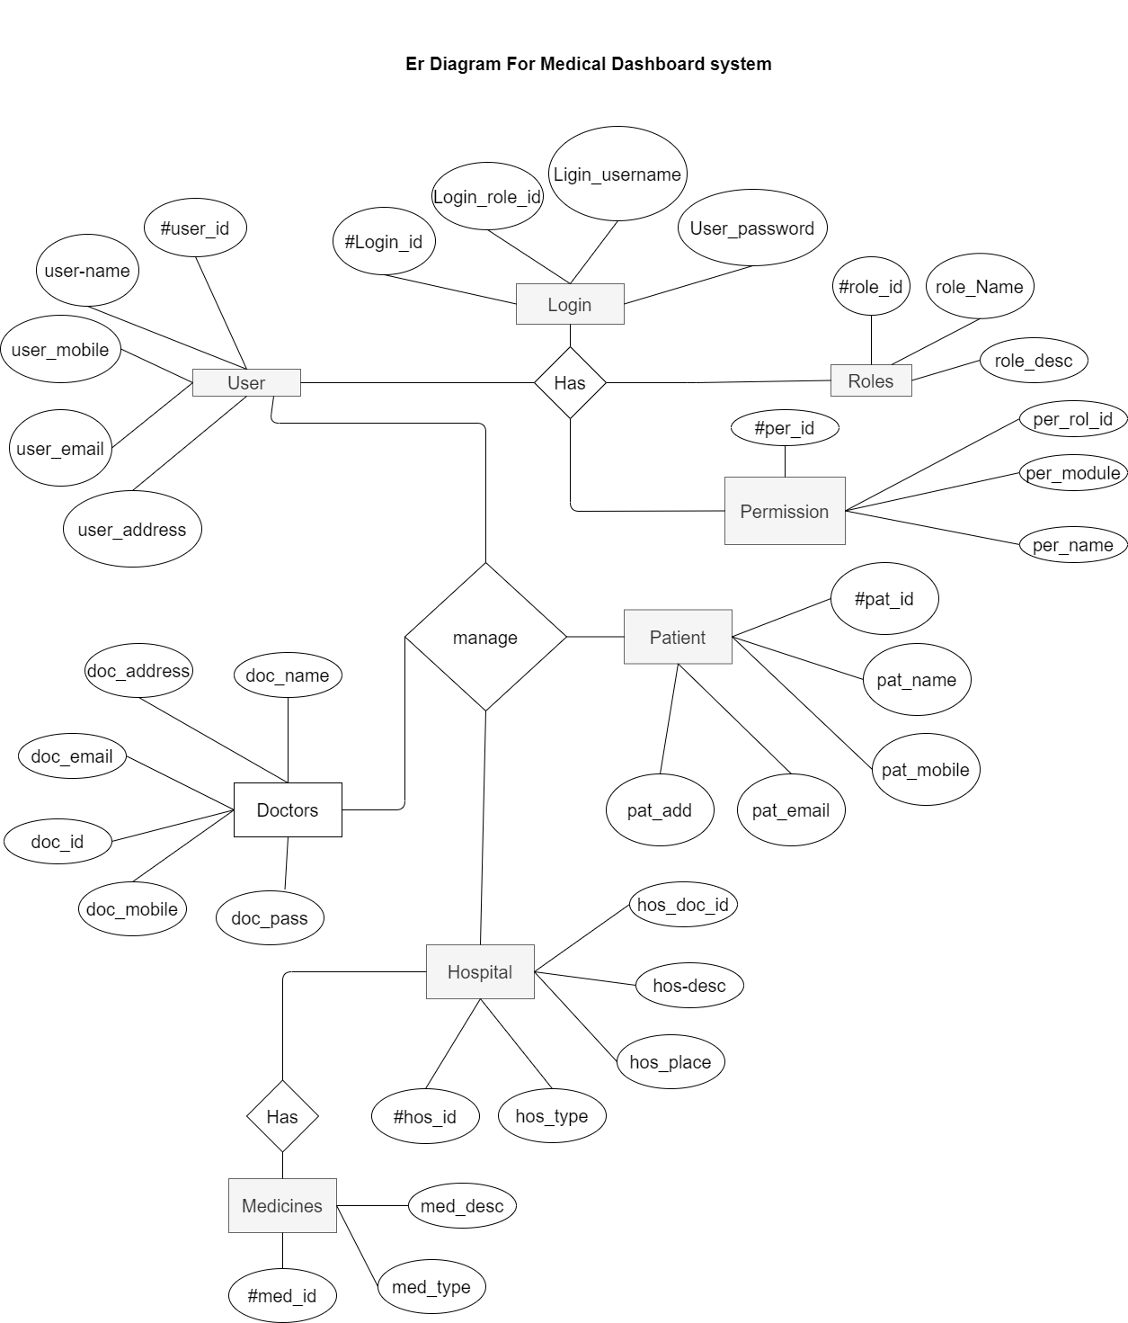
ER DIAGRAM

Slide 7
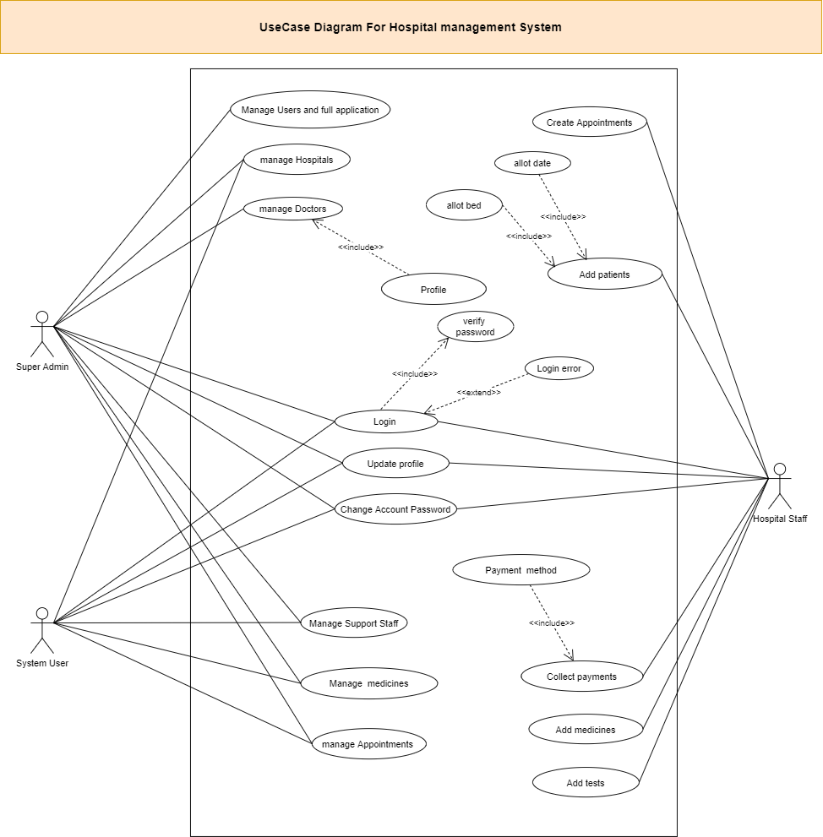
USE CASE
DIAGRAM

Slide 8
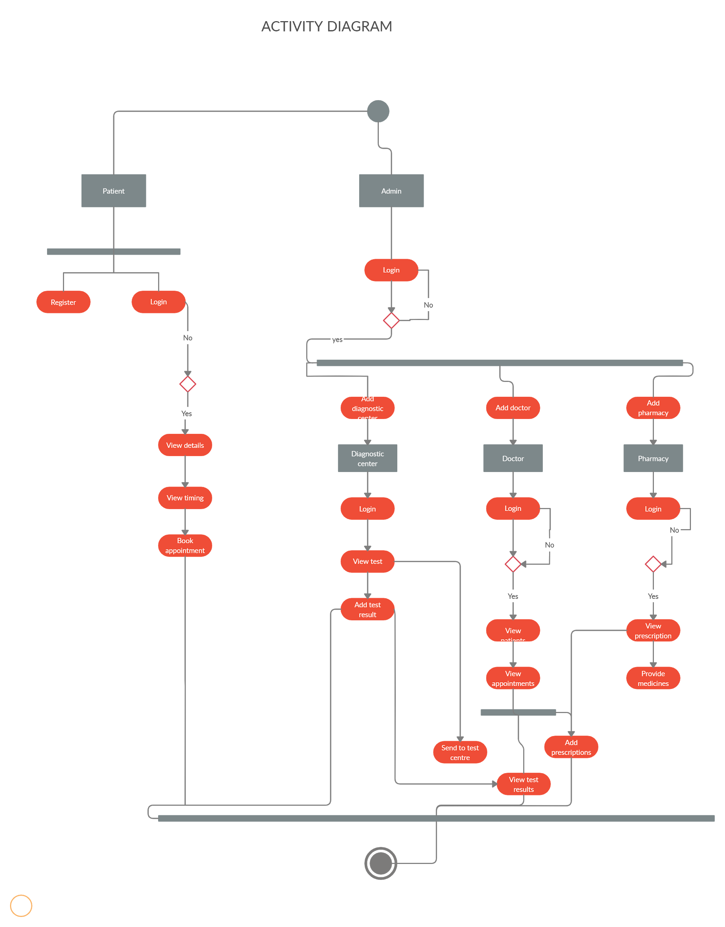
ACTIVITY
DIAGRAM

Slide 9
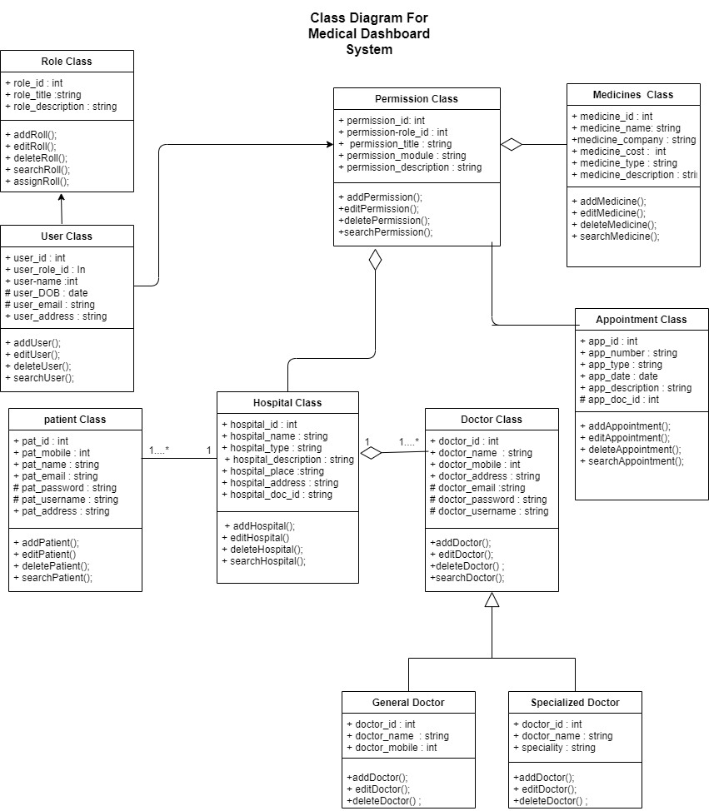
CLASS
DIAGRAM

Slide 10
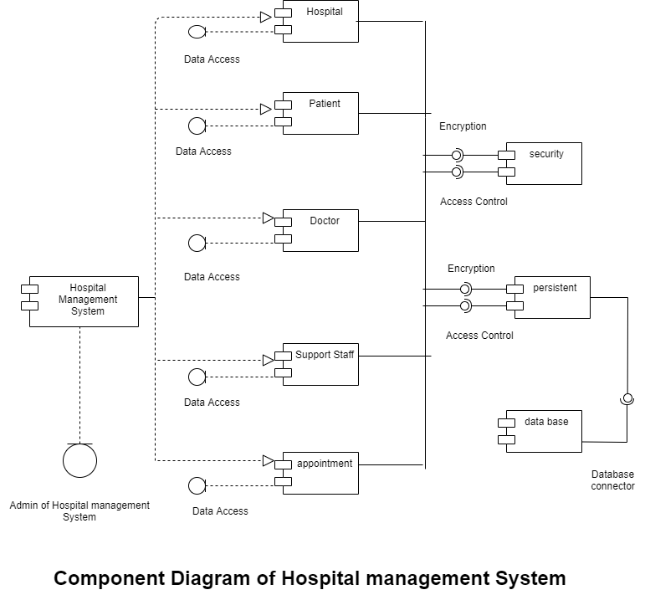
COMPONENT
DIAGRAM

Slide 11
TEST CASE 1
Login form testing
TEST CASE ID | OBJECTIVE | STEPS | EXPECTED OUTPUT | ACTUAL OUTPUT | RESULT
TEST 1 | To check the functionality of valid username and password | Enter valid username Enter correct password Click on ‘Submit’ | Valid login details should be accepted and redirected to homepage | Login successful and homepage displayed | Pass

Slide 12
TEST CASE 2
Doctor Information form testing
TEST CASE ID | OBJECTIVE | STEPS | EXPECTED OUTPUT | ACTUAL OUTPUT | RESULT
TEST 2 | To collect details of Doctor | Doctor login Personal and Academic details | Message box ‘Data saved’ | Details of Doctor added successfully | Pass

Slide 13
TEST CASE 3
Medicine Purchase testing
TEST CASE ID | OBJECTIVE | STEPS | EXPECTED OUTPUT | ACTUAL OUTPUT | RESULT
TEST 3 | Purchase medicines and payment gateway | Customer login Selection of medicines Payment | Message box ‘Payment Successful’ | Successful payment and medicine delivery | Pass

Slide 14
Thank You

